Slide 1
ADI/CU GP 2025/2026
Mostafa Yossry
Firmware Engineer

Slide 2
Content
Execution Flow
Single vs. Parallel Performance
Custom Radix-2 FFT Implementation
Next Steps

Slide 3
Prerequisites
Installing the pulp-sdk as pulp-dsp depends on it
Pulling the pulp-dsp repository
For large N (N=4096 and above) we need to increase the L1 TCDM size

Slide 4
The single FC core wakes up, initializes the Q15 data array in the massive (but slow) L2 Main Memory, packages a task pointer, and offloads it to the cluster via a hardware mailbox before going to sleep.
Execution Flow
The FC core wakes up, initializes the data array in L2 Memory, packages a task pointer, and offloads it to the cluster.
Cluster Core 0 wakes up, reads the task, and allocates L1 memory. Core 0 programs the DMA to pull the data from L2 to L1.
Core 0 configures the hardware performance counters and forks Cores 1 through 7, which wake up, divide the butterfly loops, and synchronize execution using barriers. Once finished, the data is DMA-copied back to L2.

Slide 5
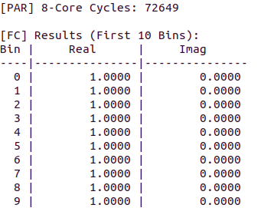
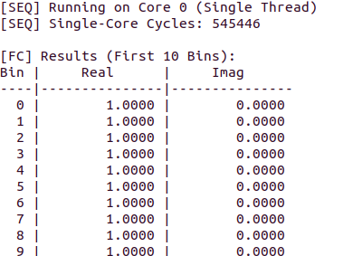
Results
Single core
Multi-core

Slide 6
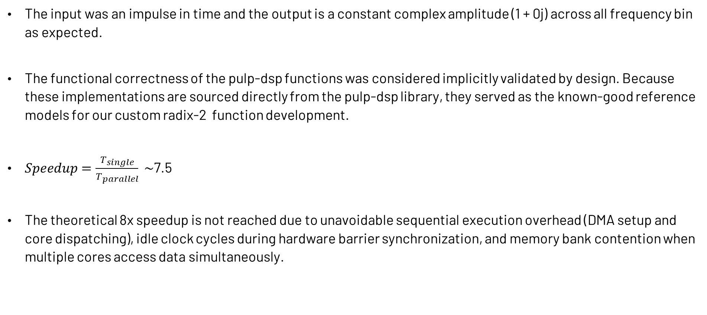
Observations
The input was an impulse in time and the output is a constant complex amplitude (1 + 0j) across all frequency bin as expected.
The functional correctness of the pulp-dsp functions was considered implicitly validated by design. Because these implementations are sourced directly from the pulp-dsp library, they served as the known-good reference models for our custom radix-2 function development.
$Speedup=\frac{T_{single}}{T_{parallel}} \sim$7.5
The theoretical 8x speedup is not reached due to unavoidable sequential execution overhead (DMA setup and core dispatching), idle clock cycles during hardware barrier synchronization, and memory bank contention when multiple cores access data simultaneously.

Slide 7
The single FC core wakes up, initializes the Q15 data array in the massive (but slow) L2 Main Memory, packages a task pointer, and offloads it to the cluster via a hardware mailbox before going to sleep.
Custom Radix-2 Implementation
Took pulp-dsp functions, wrapper structures and naming conventions as a reference, also used some of the helper functions such as bit reversal .
Initially built Radix-2 algorithm using standard C math to verify functionality.
upgraded the scalar standard C math to utilize custom RISC-V vector extension. Using __PACK2, __ADD2, __DOTP2, etc...
Measured the performance of the whole function then the performance of the butterfly

Slide 8

Results
Radix-2 FFT (N=4096)
Butterfly
Before running it on multiple cores and using vector operations, It was 1 Million Cycles approx.
Operations being measured:
$$A^{′}=A+B$$
$$B^{′}=\left(A−B\right)×W$$

Slide 9
What's Next?
System Model Integration: Lock down the exact Q-notation and input bit-width (e.g., 12-bit ADC inputs)
Verification: Comprehensive validation of the C-level fixed point function against MATLAB model made by Fathy
Hardware Accelerator Integration: Replace the C-code butterfly with dedicated hardware made by Darwish

Slide 10
GitHub Repository
Source code can be found here:
https://github.com/Mostafa-Yossry/ADI-CU-GP-2025-2026/tree/main/Firmware/Radix2-FFT

